Slide 1

Capstone Project – 3
Machine Learning – Classification
Team Champions : Coronavirus Tweet Sentiment Analysis
Team Members
Varsha Rani
Vivek Chandrakant Pawar
Rabista Parween
Tushar Gaikwad

Slide 2
POINTS FOR DISCUSSION
Problem Description
Data Summary
Data Inspection
Feature Engineering
Exploratory Data Analysis
Data Modeling
Performance Metrics and Accuracy
Confusion Metrics
Conclusion

Slide 3
Problem Description
This challenge asks us to build a classification model to predict the sentiment of COVID-19 tweets. The tweets have been pulled from Twitter and manual tagging has been done then.
The names and usernames have been given codes to avoid any privacy concerns.
We are given the following information:
Location
Tweet At
Original Tweet
Label

Slide 4
Data Summary
We are given data set : Coronavirus Tweets.csv
We are given the dataset having 6 columns –
UserName
ScreenName
Location
TweetAt
OriginalTweet
Sentiment
We have removed punctuation and stop words from ‘OriginalTweet’ column and added a new column ‘clean_tweets’ to the dataset.
We have done classification using five models namely –
Logistic Regression Model
Decision Tree Classifier
Random Forest Classifier
Gradient Boosting Classifier
Passive Aggressive Classifier.

Slide 5
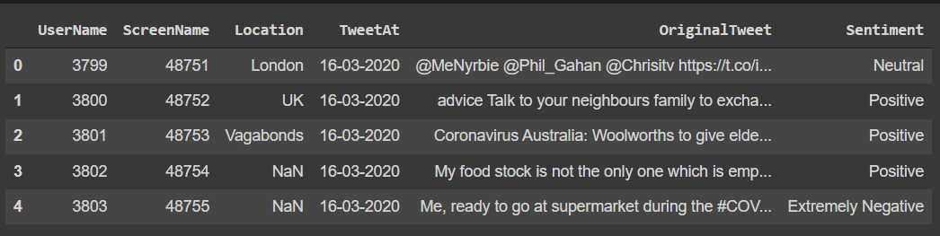
Importing Libraries & Data Inspection
Pandas – Manipulation of tabular data in Dataframes
Numpy – Mathematical operations on arrays
Matplotlib – Visualization
Seaborn – Visualization
Sklearn – Data Modeling
Nltk – Pre Processing / Feature Engineering
WordCloud – Visualization
Original Dataset contains 6 columns and 41157 rows.

Slide 6
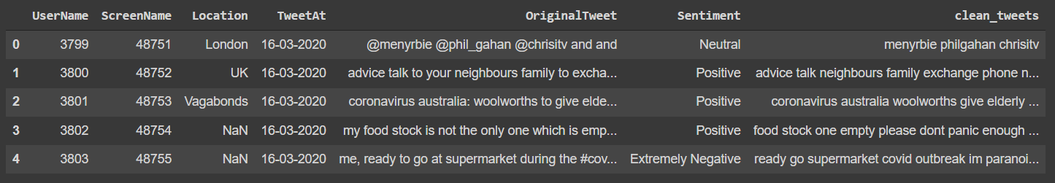
Feature Engineering
Step 1 : Converted all characters to lowercase.
Step 2 : Removed Punctuation.
Step 3 : Removed stop words.
After dropping the null values and adding a new column ‘clean_tweets’, now we have 7 columns and 32567 rows.

Slide 7
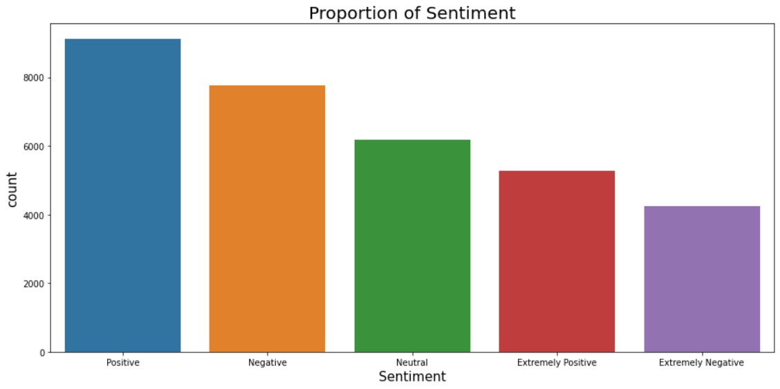
Exploratory Data Analysis
Sentiments
There are five types of sentiments. The above graph shows count of each sentiment.

Slide 8
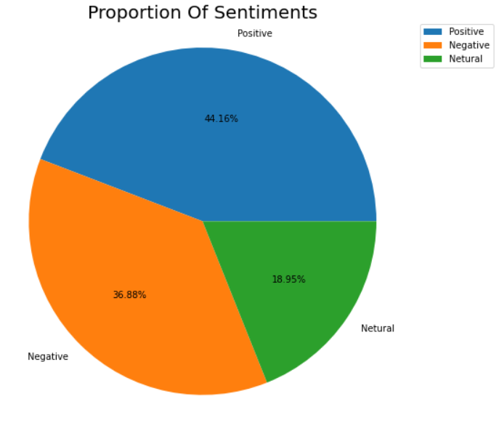
EDA Continued…
New Sentiments
As there was five types of sentiments – Positive Sentiment, Extremely Positive Sentiment, Negative Sentiment, Extremely Negative Sentiment and Neutral Sentiment. So, we have replaced Extremely Positive Sentiment by Positive Sentiment and Extremely Negative Sentiment by Negative Sentiment. Now we have three types of sentiments – Positive Sentiment, Negative Sentiment and Neutral Sentiment.
The Pi Chart shows the proportion of each sentiment.
There are 44.16% Positive Sentiments, 36.88% Negative Sentiments and 18.95% Neutral Sentiments.
Positive Sentiments are having higher proportion among all.

Slide 9
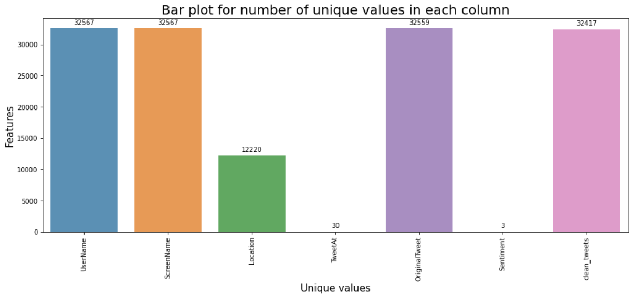
EDA Continued…
Unique values in each column
The above graph shows unique values in each column.

Slide 10
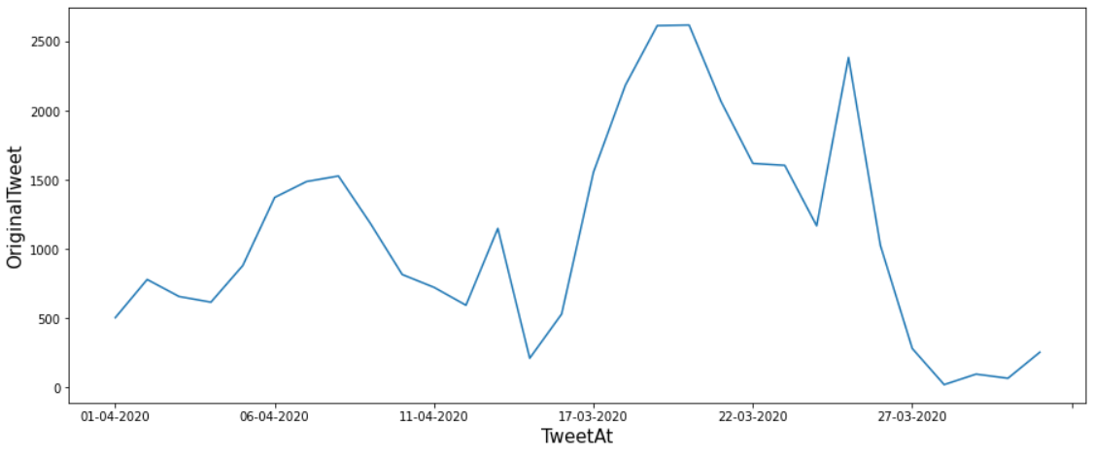
EDA Continued…
Original Tweet according to ‘TweetAt’ column
The above graph shows OriginalTweet according to TweetAt column.

Slide 11
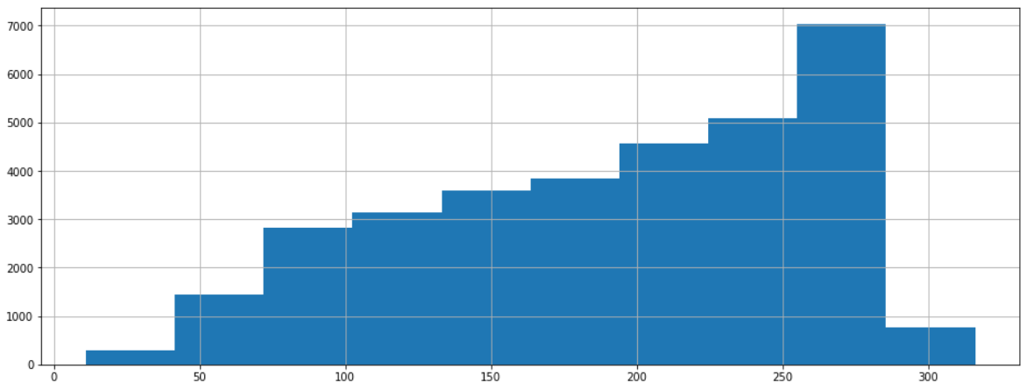
EDA Continued…
Histogram plot of Original Tweet
The above histogram plot shows original tweets.

Slide 12
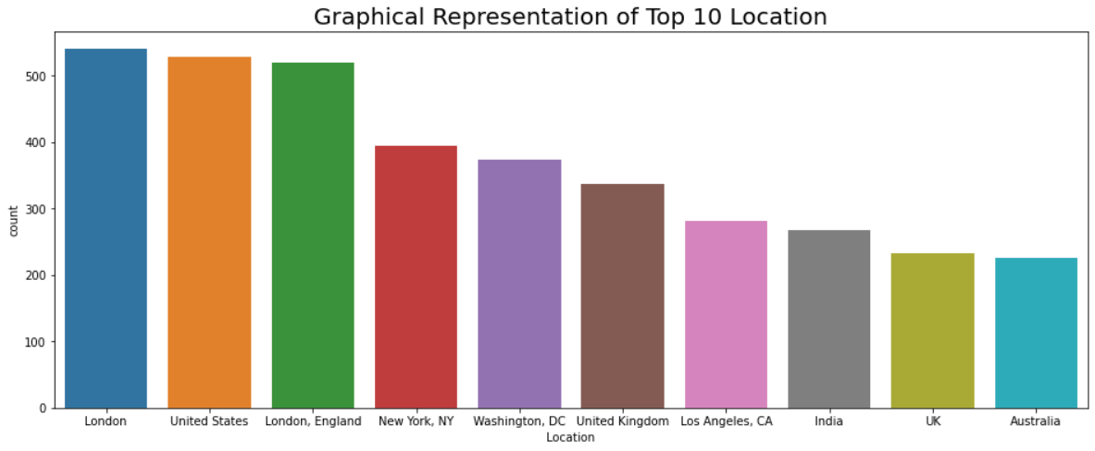
EDA Continued…
Top 10 Locations
The above graph shows top 10 locations from where tweets are received. Most tweets received from London followed by United States.

Slide 13
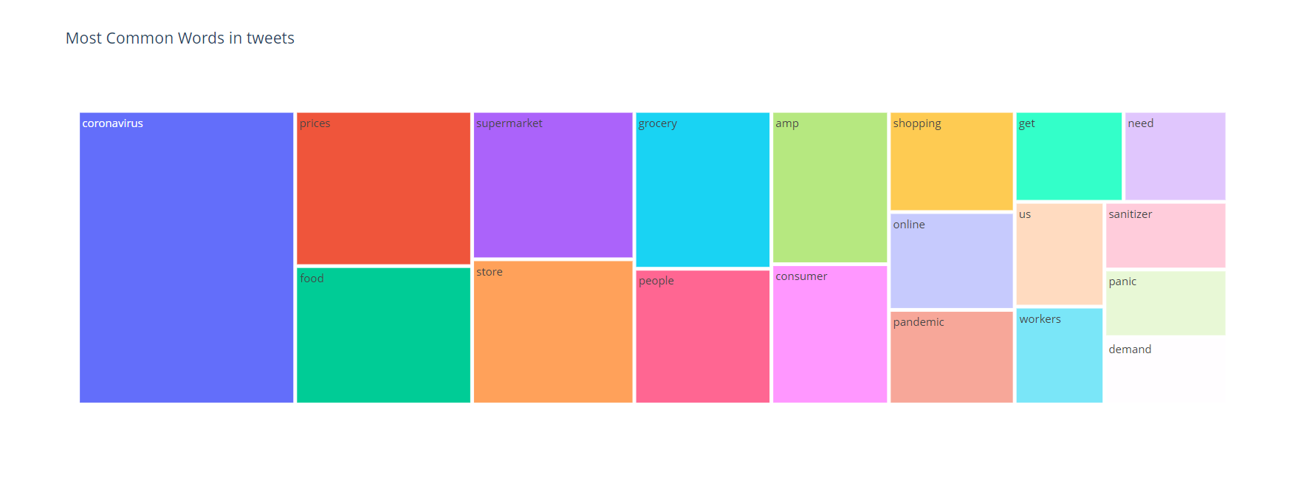
EDA Continued…
Most common words in tweets

Slide 14
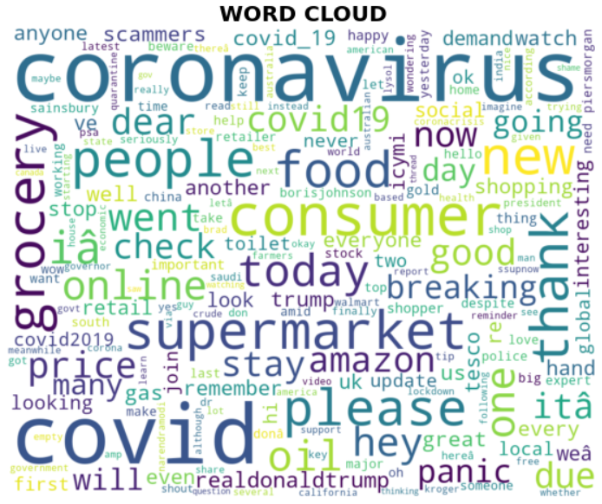
EDA Continued…
Word Cloud
Word Clouds are visual displays of text data – simple text analysis. Word Clouds display the most prominent or frequent words in a body of text.

Slide 15
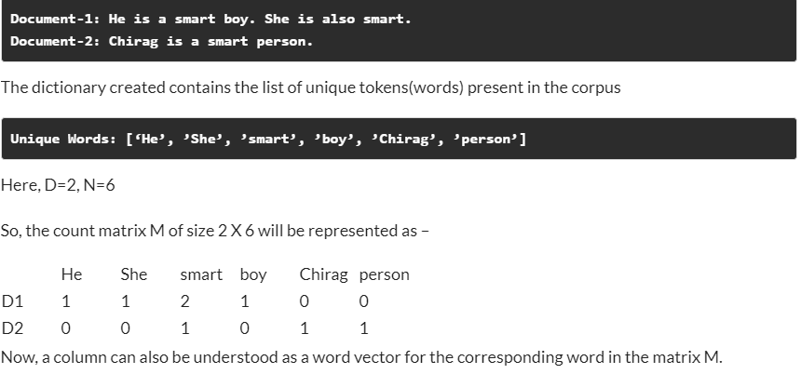
Model Preprocessing
Extracting Features From Text
Count Vectorizer - CountVectorizer is a great tool provided by the scikit-learn library in Python. It is used to transform a given text into a vector on the basis of the frequency (count) of each word that occurs in the entire text.

Slide 16
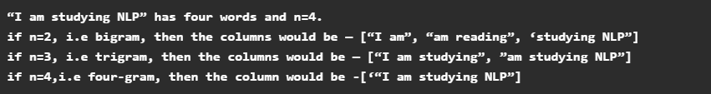
Model Preprocessing
Extracting Features From Text
NGram Vectorizer - Similar to the count vectorization technique, in the N-Gram method, a document term matrix is generated, and each cell represents the count. Count vectorization is a special case of N-Gram where n=1. N-grams consider the sequence of n words in the text; where n is (1,2,3.. ) like 1-gram, 2-gram. for token pair. Unlike BOW, it maintains word order.
If we choose N as a smaller number, then it may not be sufficient enough to provide the most useful information. But on the contrary, if we choose N as a high value, then it will yield a huge matrix with lots of features. Therefore, N-gram may be a powerful technique, but it needs a little more care.

Slide 17
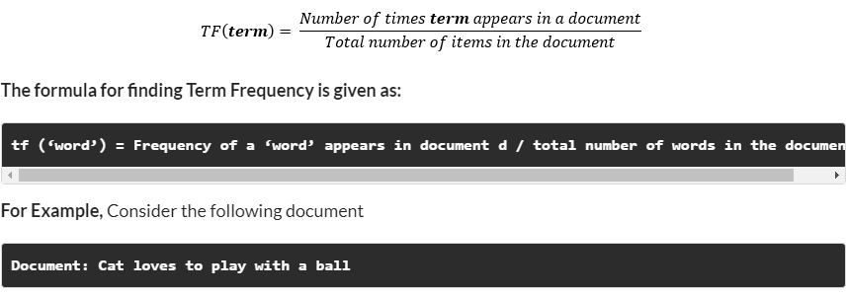
Model Preprocessing
Extracting Features From Text
TF-IDF - Count Vectorizer method is simple and works well, but the problem with that is that it treats all words equally. As a result, it cannot distinguish very common words or rare words. So, to solve this problem, TF-IDF comes into the picture! Term frequency-inverse document frequency ( TF-IDF) gives a measure that takes the importance of a word into consideration depending on how frequently it occurs in a document and a corpus.
TF – Term Frequency
Term frequency denotes the frequency of a word in a document.
It is the percentage of the number of times a word (x) occurs in a particular document (y) divided by the total number of words in that document

Slide 18
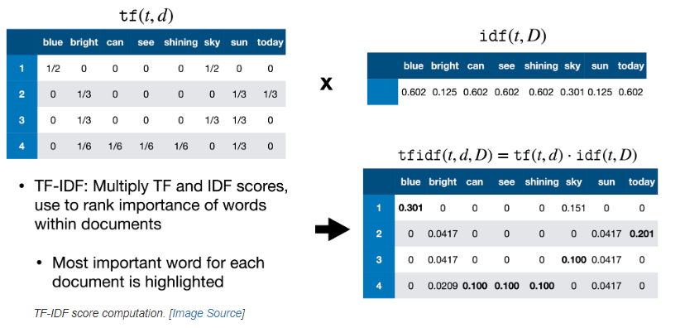
Model Preprocessing
Extracting Features From Text
Inverse Document Frequency - It measures the importance of the word in the corpus. It measures how common a particular word is across all the documents in the corpus.
It is the logarithmic ratio of no. of total documents to no. of a document with a particular word.
The difference in the TF-IDF method is that each cell doesn’t indicate the term frequency, but contains a weight value that signifies how important a word is for an individual text message or document

Slide 19
Model Training
Algorithm Used
Logistic Regression
Decision Tree
Random Forest
Gradient Boosting

Slide 20
Performance Metrics and Accuracy
Performance of Logistic Regression Model
Accuracy : 0.7710636207320068
Precision : 0.7857896154337569
Recall : 0.7710636207320068
Performance of Decision Tree Classifier
Accuracy : 0.6129943502824858
Precision : 0.6109013482361811
Recall : 0.6129943502824858
Performance of Random Forest Classifier
Accuracy : 0.7248833210513388
Precision : 0.7282331957151178
Recall : 0.7248833210513388

Slide 21
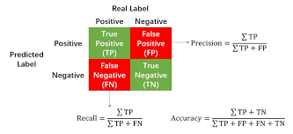
Performance Metrics and Accuracy
Performance of Gradient Boosting Classifier
Accuracy : 0.6545074920167036
Precision : 0.6962747491301503
Recall : 0.6545074920167036
Precision Accuracy And Recall

Slide 22
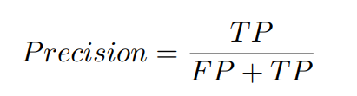
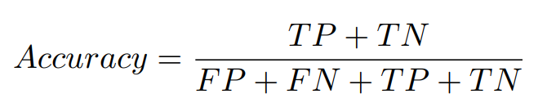
Precision Accuracy And Recall
Precision
Precision is the proportion of correct predictions among all predictions of a certain class. In other words, it is the proportion of true positives among all positive predictions.
Accuracy
Accuracy is the proportion of examples that were correctly classified. More precisely, it is sum of the number of true positives and true negatives, divided by the number of examples in the dataset.

Slide 23

Precision Accuracy And Recall
Recall
Recall is the proportion of examples of a certain class that have been predicted by the model as belonging to that class. In other words, it is the proportion of true positives among all true examples.

Slide 24
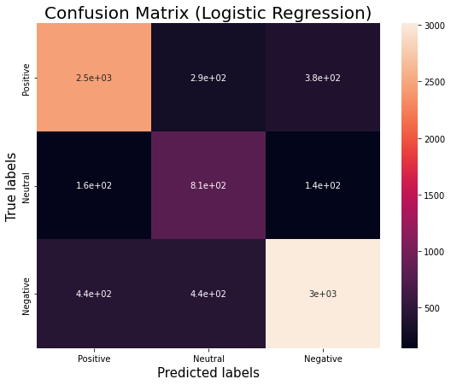
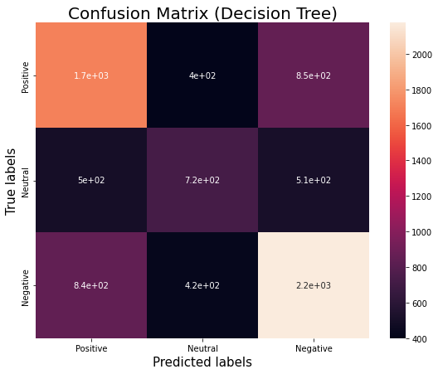
Confusion Matrix
A Confusion matrix is an N x N matrix used for evaluating the performance of a classification model, where N is the number of target classes.

Slide 25
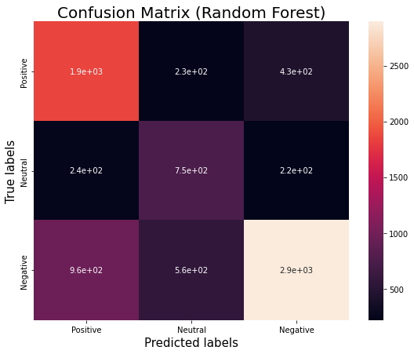
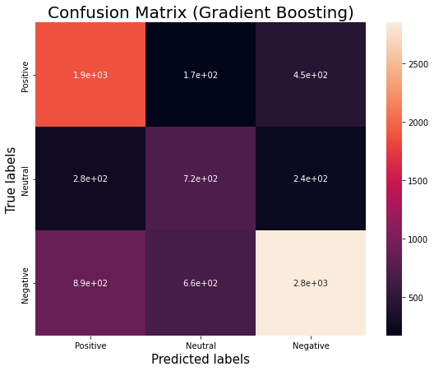
Confusion Matrix

Slide 26
Conclusion
Conclusion on EDA:
Original Dataset contains 6 columns and 41157 rows.
Location column contains null values. So, we have dropped the null values.
And we added a new column "clean_tweets" after cleaning the tweets.
After dropping and adding a new column, now we have 7 columns and 32567 rows.
In order to analyze the data we required only two columns "OriginalTweet" and "Sentiment".
The columns such as "UserName" and "ScreenName" does not give any meaningful insights for our analysis.
There are five types of sentiments - Extremely Positive, Positive, Extremely Negative, Negative and Neutral.
We have renamed the Extremely Positive and Extremely Negative sentiments to Positive and Negative respectively. And we are left with three types of sentiments - Positive, Negative and Neutral.
The pie chart shows the proportion of sentiments.
Bar plot for unique values shows us the number of unique values in each column.
The graphical representation of top 10 locations shows us that most of the tweets came from London followed by United States.
Conclusion on Model Training:
At the end we conclude our classification project with five models namely - Logistic Regression Model, Decision Tree Classifier, Random Forest Classifier and Gradient Boosting Classifier.
We are getting the highest accuracy of about 77% with Logistic Regression.

Slide 27

Thank You!!

